Slide 1
Visualizing and Understanding Convolutional Networks
Anuj Dimri

Slide 2
Renewed Interest in Convnet models
Availability of larger training sets
Powerful GPU implementations, making the training of very large models practical
Better regularization strategies, such as Dropout

Slide 3
Still little insight into the internal operation and behavior of these complex models, or how they achieve such good performance
Problem
Notes:
Without clear understanding of how and why they work, the development of better models is reduced to trial-and-error

Slide 4
Proposed Solution
Introduce a visualization technique that reveals the input stimuli that excite individual feature maps at any layer in the model.
Main idea: project the feature activations back to the input pixel space
Notes:
allows us to observe the evolution of features during training and to diagnose potential problems with the model.
also perform sensitivity analysis of the classifier output by occluding portions of the input image, revealing which parts of the scene are important for classification.

Slide 5
Deconvolutional Neural Network (deconvnet)
A deconvnet can be thought of as a convnet model that uses the same components (filtering, pooling) but in reverse, so instead of mapping pixels to features does the opposite.
Notes:
what input pattern originally caused a given activation in the feature maps

Slide 6
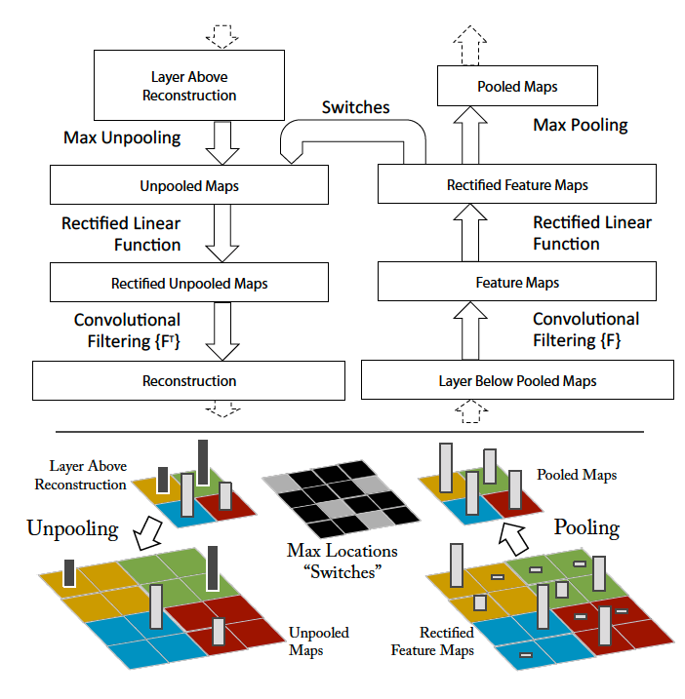
Reverse of convnets
Unpooling
Reconstruction from the layer above into appropriate locations, preserving the structure
Rectification
Filtering
transposed versions of the filters are applied to the rectified maps.
Notes:
Unpooling: obtain an approximate inverse by recording the locations of the maxima within each pooling region in a set of switch variables.
As these switch settings are peculiar to a given input image, the reconstruction obtained from a single activation thus resembles a small piece of the original input image,

Slide 7
Training Details
Model details
Trained on ImageNet 2012 training set (1.3 million images, spread over 1000 different classes)
Preprocessing done
cropping center 256X256 region
subtracting per pixel mean
SGD with mini batch size of 128 was used
Learning rate 0.01, momentum 0.9 (Learning rate was annealed when validation error plateaus)
Dropout with rate 0.5 in fully connected layers (6 and 7)
All weights initialized to 0.01 and biases are set to 0
Epochs set to 70 (12 days on a single GTX580 GPU)
Notes:
Shouldn’t the weights be randomly initialized to different numbers?? here all are same.
why batch sizes are in powers of 2?
Where should dropout be applied? earlier in the n/w or later ??? Here it is applied later in the n/w. Why ??

Slide 8
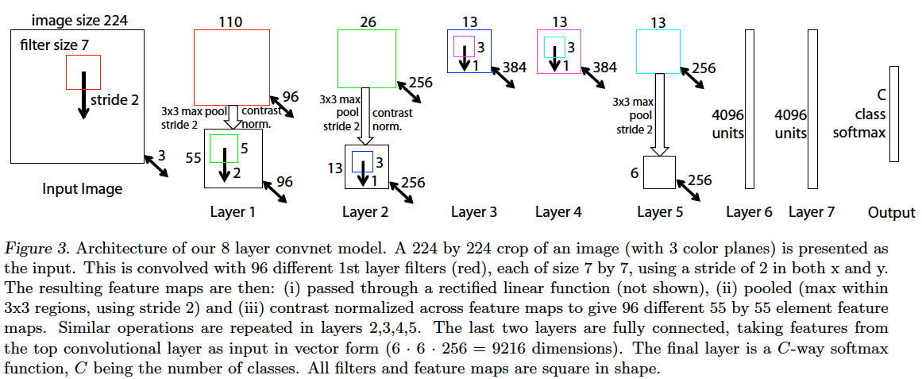
Model Architecture

Slide 9
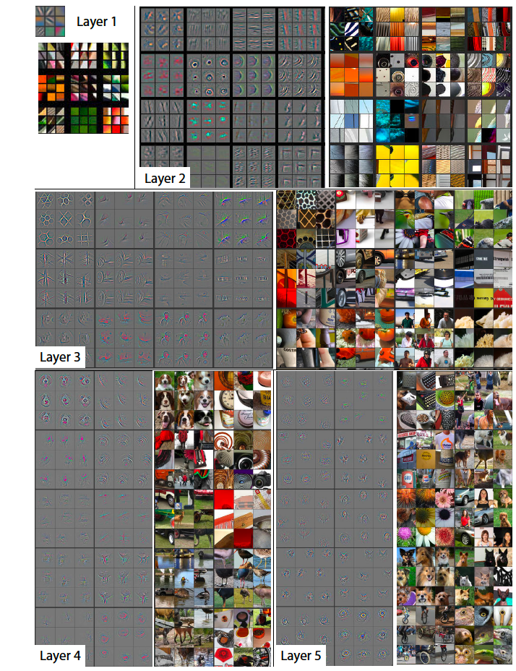
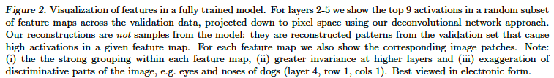
What individual layers are learning
Layer2: corners and other edge/color conjunctions
Layer3: captures similar textures (mesh pattern (R1C1), text (R2C4))
Layer4: more class specific (dog faces (R1C1), bird’s legs (R4C2))
Layer5: shows entire objects with significant pose variation (keyboards (R1C1) and dogs(R4))

Slide 10
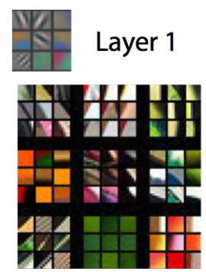

Slide 11
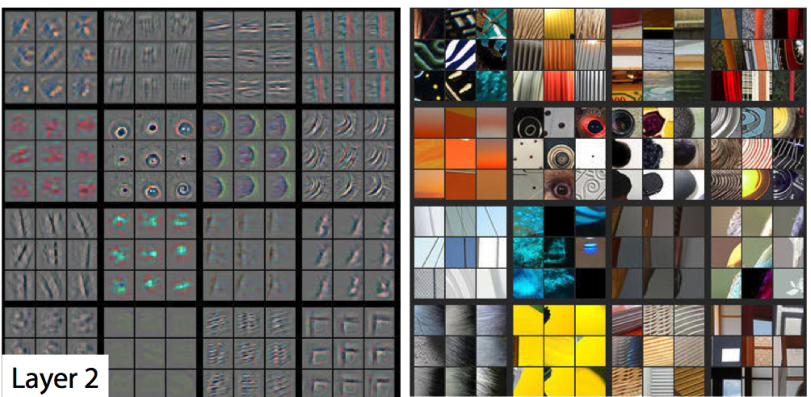
Layer2: corners and other edge/color conjunctions

Slide 12
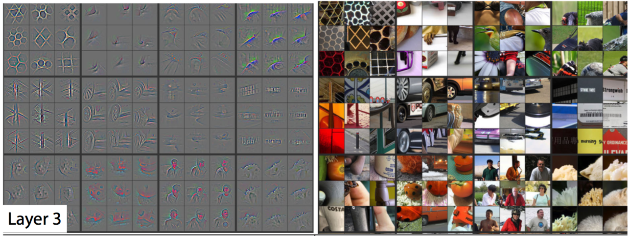
Layer3: captures similar textures (mesh pattern (R1C1), text (R2C4))

Slide 13
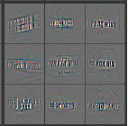
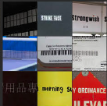

Slide 14
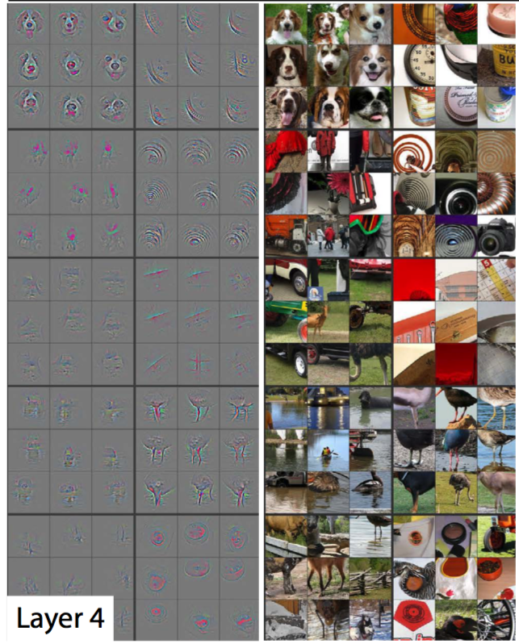
Layer4: more class specific (dog faces (R1C1), bird’s legs (R4C2))

Slide 15
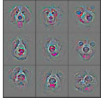
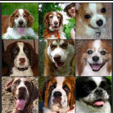

Slide 16
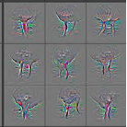
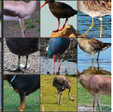

Slide 17
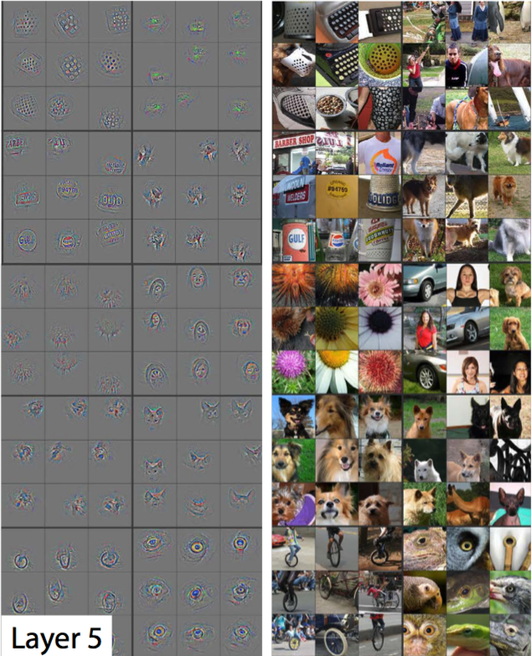
Layer5: shows entire objects with significant pose variation (keyboards (R1C1) and dogs(R4))
Notes:
For example, in layer 5, row 1, col 2, the patches appear to have little in common, but the visualizations reveal that this particular feature map focuses on the grass in the background, not the foreground objects

Slide 18
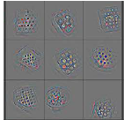
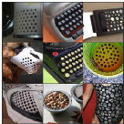

Slide 19
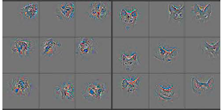
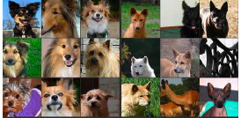

Slide 20
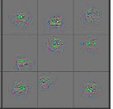
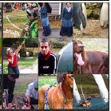
Notes:
For example, in layer 5, row 1, col 2, the patches appear to have little in common, but the visualizations reveal that this particular feature map focuses on the grass in the background, not the foreground objects

Slide 21
Benefits of visualization
Can assist in selecting good architectures (thereby increasing classification accuracy)
Occlusion Sensitivity
Is the model truly identifying the location of the object in the image, or just using the surrounding context?
Notes:
systematically occluding different portions of the input image with a grey square, and monitoring the output of the classifier
The examples clearly show the model is localizing the objects within the scene, as the probability of the correct class drops significantly when the object is occluded

Slide 22
Model Architecture

Slide 23
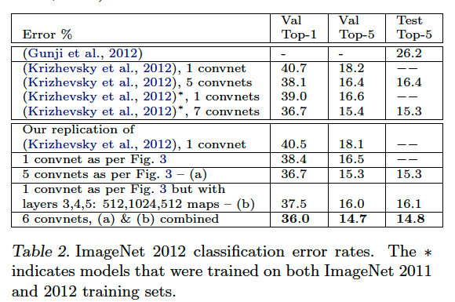
Results on Imagenet

Slide 24
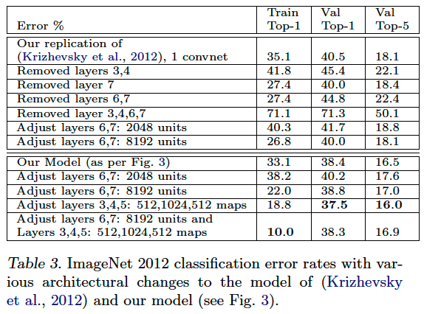
Varying ImageNet model sizes
Notes:
Removing fully connected layers (6,7) only gives a slight increase in error. This is surprising, given that they contain the majority of model parameters.
Removing both the middle convolutional layers also makes a relatively small difference to the error rate
However, removing both the middle convolutional layers and the fully connected layers yields a model with only 4 layers whose performance is dramatically worse.
This suggests that overall depth of the model is important for obtaining good performance
Changing size of the fully connected layers makes little difference to performance
However, increasing the size of the middle convolution layers gives a useful gain in performance

Slide 25
Takeaways till now..
The above results show the importance of convolutional part of the ImageNet model.
This is supported by the visualizations also which shows complex invariances learned in the convolutional layers.

Slide 26
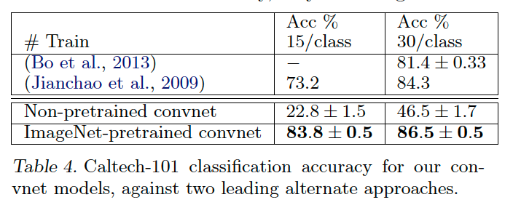
Generalization to other datasets
Caltech-101

Slide 27
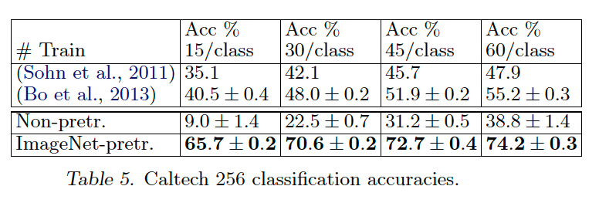
Caltech-256

Slide 28
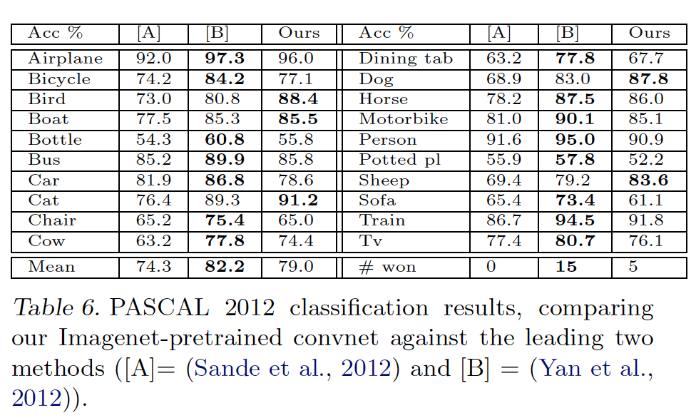
Pascal 2012
Notes:
The PASCAL and ImageNet images are quite different in nature, the former being full scenes unlike the latter. This may explain our mean performance being 3:2% lower than the leading (Yan et al., 2012) result, however we do beat them on 5 classes, sometimes by large margins
This is not ideal, as PASCAL images can contain multiple objects and our model just provides a single exclusive prediction for each image.

Slide 29
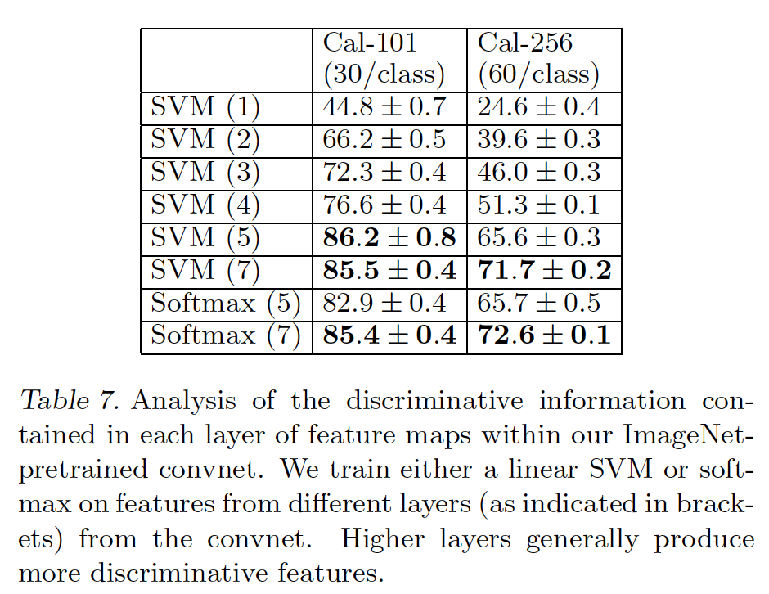
Feature Analysis
Notes:
We do this by varying the number of layers retained from the ImageNet model and place either a linear SVM or softmax classifier on top. Table 7 shows results on Caltech-101 and Caltech-256.
a steady improvement can be seen as we ascend the model, with best results being obtained by using all layers. This supports the premise that as the feature hierarchies become deeper, they learn increasingly powerful features.

Slide 30
THANK YOU

